Slide 1
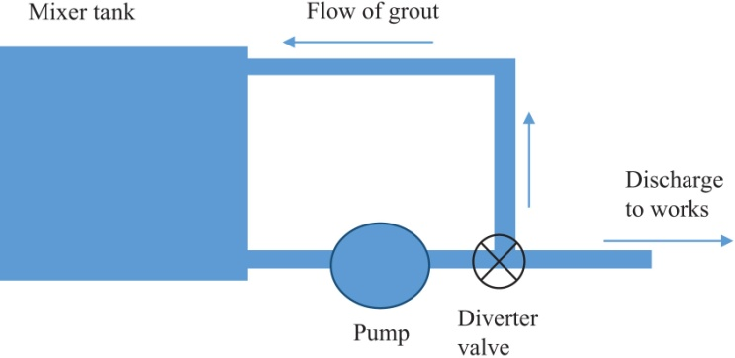
FIGURE 28.1 Schematic Arrangement of Grout Mixer
Copyright © 2016 Elsevier Ltd. All rights reserved.

Slide 2
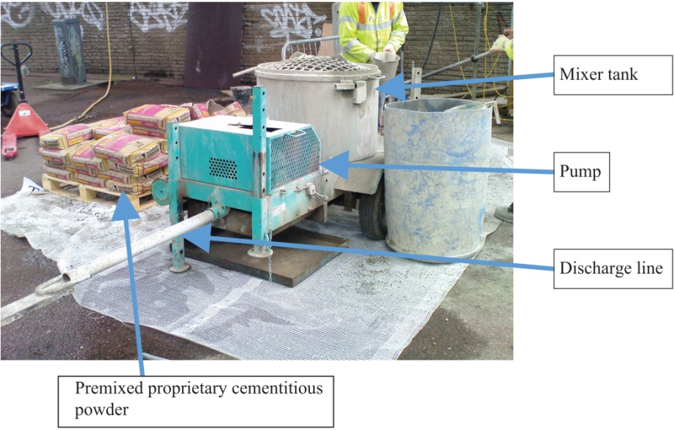
FIGURE 28.2 Grout Mixer
Copyright © 2016 Elsevier Ltd. All rights reserved.

Slide 3
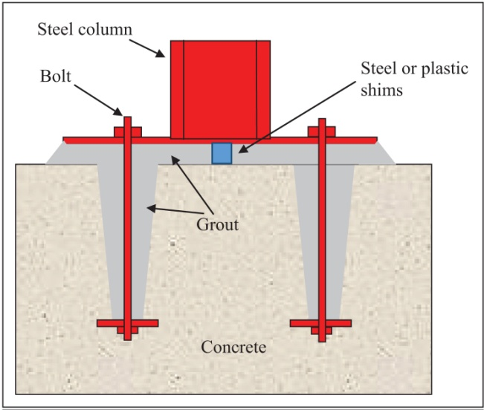
FIGURE 28.3 Arrangement of Holding Down Bolts for Steel Column
Copyright © 2016 Elsevier Ltd. All rights reserved.

Slide 4
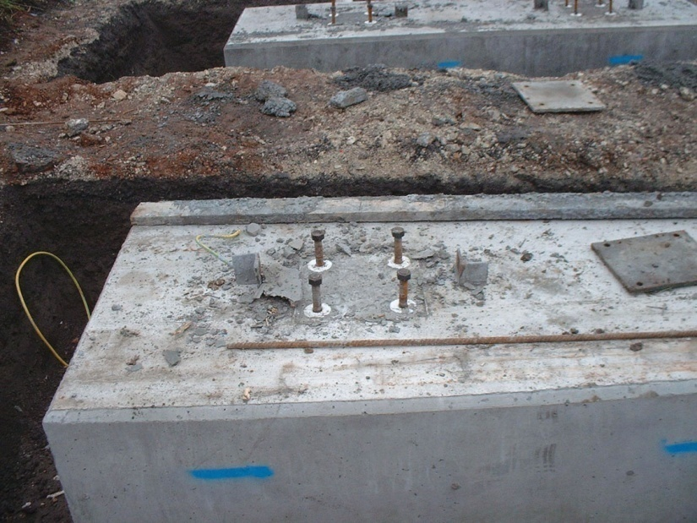
FIGURE 28.4 Holding Down Bolts With the Expanded Polystyrene Void Formers Still in Position Around Them
Copyright © 2016 Elsevier Ltd. All rights reserved.

Slide 5
FIGURE 28.5 Typical Bridge Deck Bearing Arrangement
Copyright © 2016 Elsevier Ltd. All rights reserved.

Slide 6
FIGURE 28.6 Arrangement of Prestressing Duct in Bridge Deck
Copyright © 2016 Elsevier Ltd. All rights reserved.

Slide 7
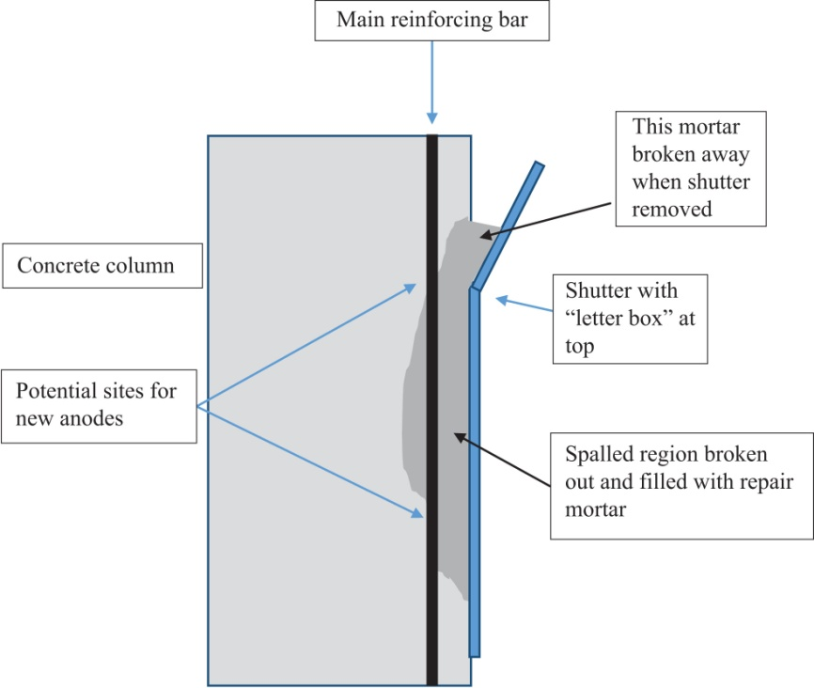
FIGURE 28.7 Typical Arrangement for Repair Mortar
Copyright © 2016 Elsevier Ltd. All rights reserved.

Slide 8
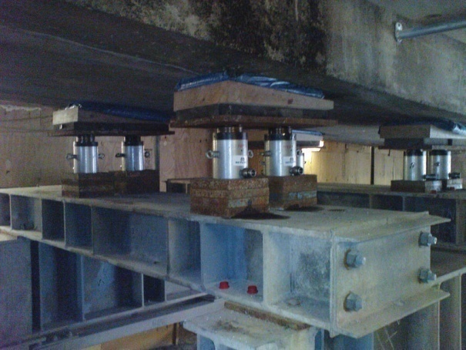
FIGURE 28.8 Repair Sequence 1
Copyright © 2016 Elsevier Ltd. All rights reserved.

Slide 9
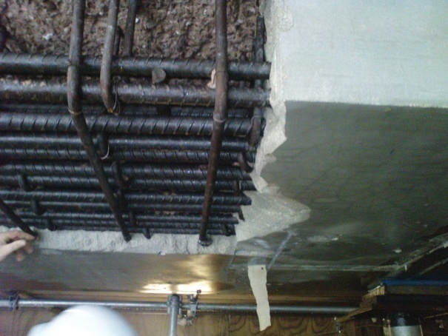
FIGURE 28.9 Repair Sequence 2
Copyright © 2016 Elsevier Ltd. All rights reserved.

Slide 10
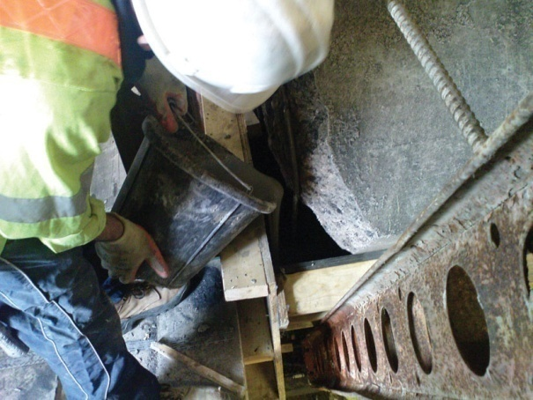
FIGURE 28.10 Repair Sequence 3
Copyright © 2016 Elsevier Ltd. All rights reserved.

Slide 11
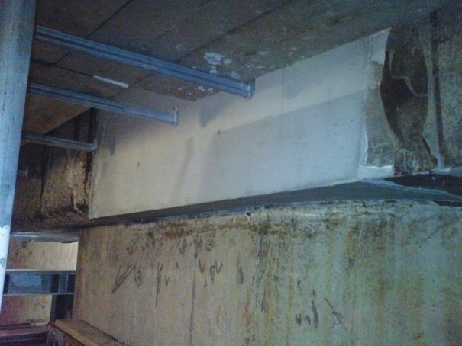
FIGURE 28.11 Repair Sequence 4
Copyright © 2016 Elsevier Ltd. All rights reserved.

